Slide 1
KDOT - Woodlawn Avenue Reconstruction
April 4th, 2023
City of the Future with Respect for its Past

Slide 2

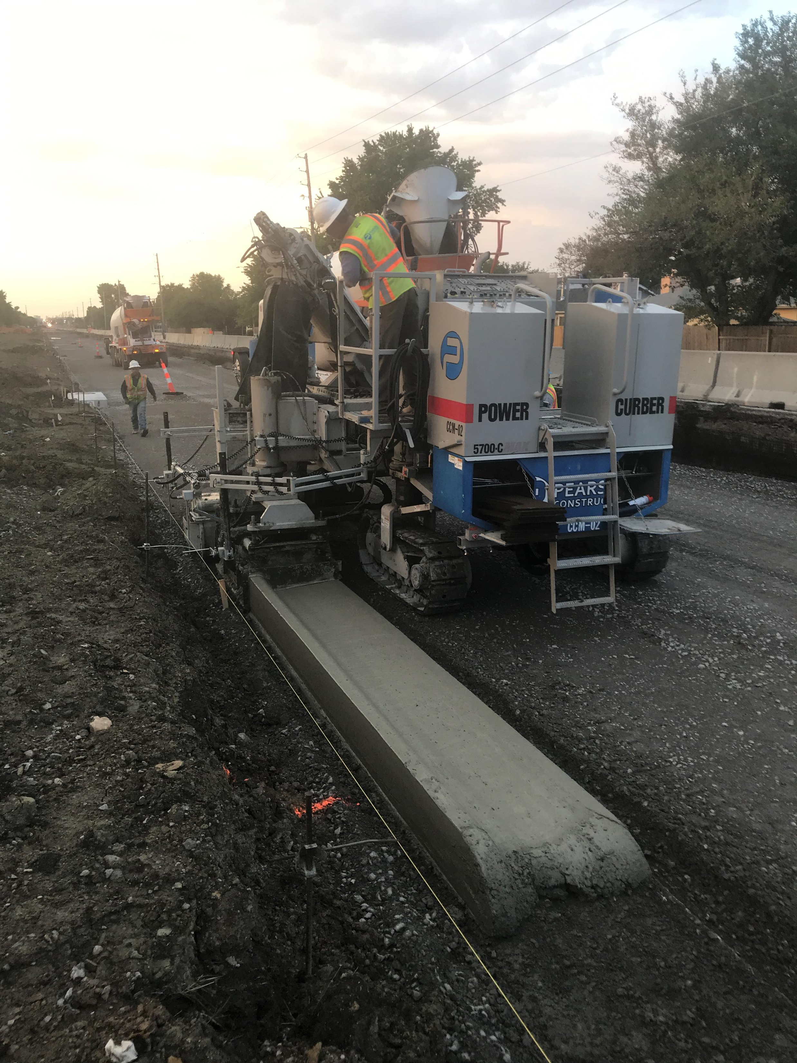

Safety Statement
Weather related concerns with construction activity (SPRINGTIME EDITION)
Be aware of changing conditions
Use a trusted source for keeping you informed on weather forecast
Have a plan if the weather starts to get bad
  Know where to exit the area
  Designate a muster area
  Communicate with the people around you
  Be prepared to leave the site and find shelter in the event of a tornado…

Slide 3
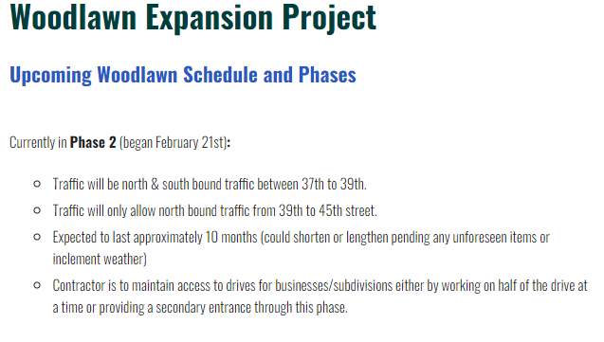
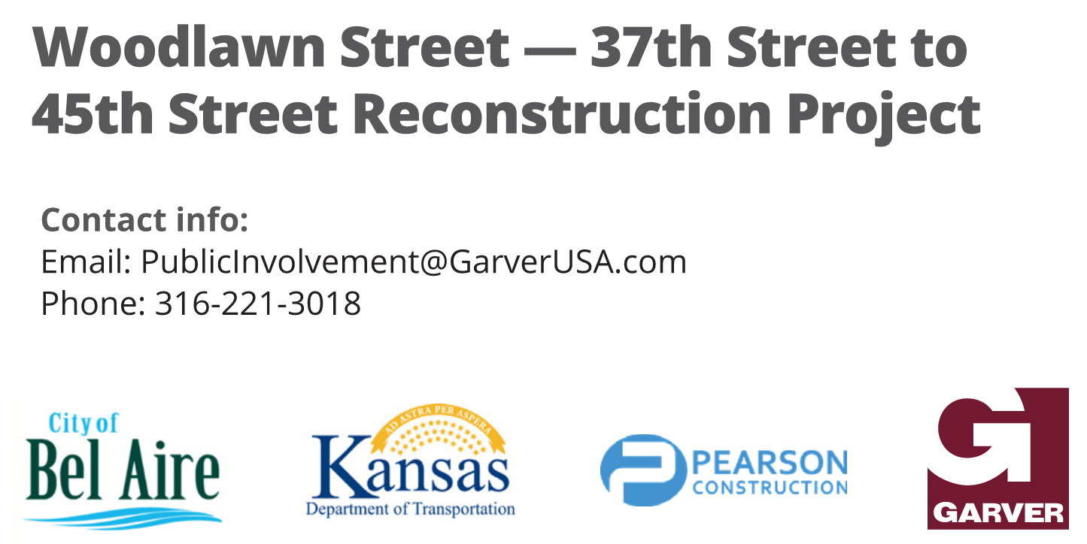
Updates – Bel Aire Website/Social Media
https://www.belaireks.gov/347/Woodlawn-Expansion-Project

Slide 4
Working Day Progress
Working Days – 69% Complete
  Charged: 271 Working Days
  Charged 30 WD’s since last meeting (2-21-2023)
  Contracted: 390 Working Days + 40 Cleanup Days
  The contractor has requested an additional 57 working days be added for the delays associated with railroad crossing. Contractor and KDOT has agreed to terms and the change order is in Topeka for signatures.

Slide 5
Current Activities
Utilities
Storm Sewer Drain lines and boxes along the west half of Woodlawn
Some Utility conflicts have been found. Contractor working with the City of Bel Aire to get these issues worked out so progress can continue.
Mainline
Subgrade and Aggregate Base installation operations along the west side of Woodlawn
Curb and Gutter placement

Slide 6
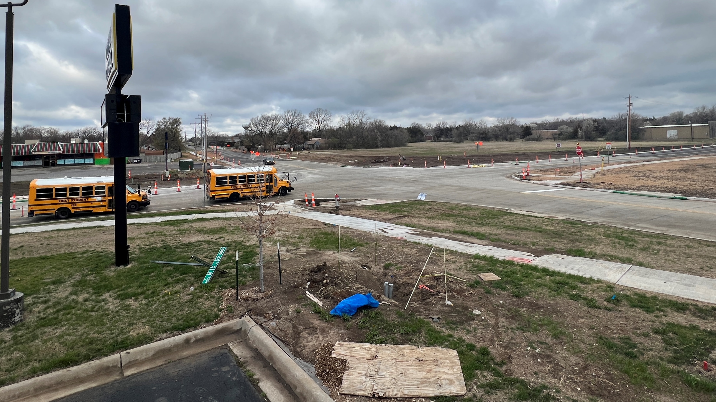
Current Activities

Slide 7
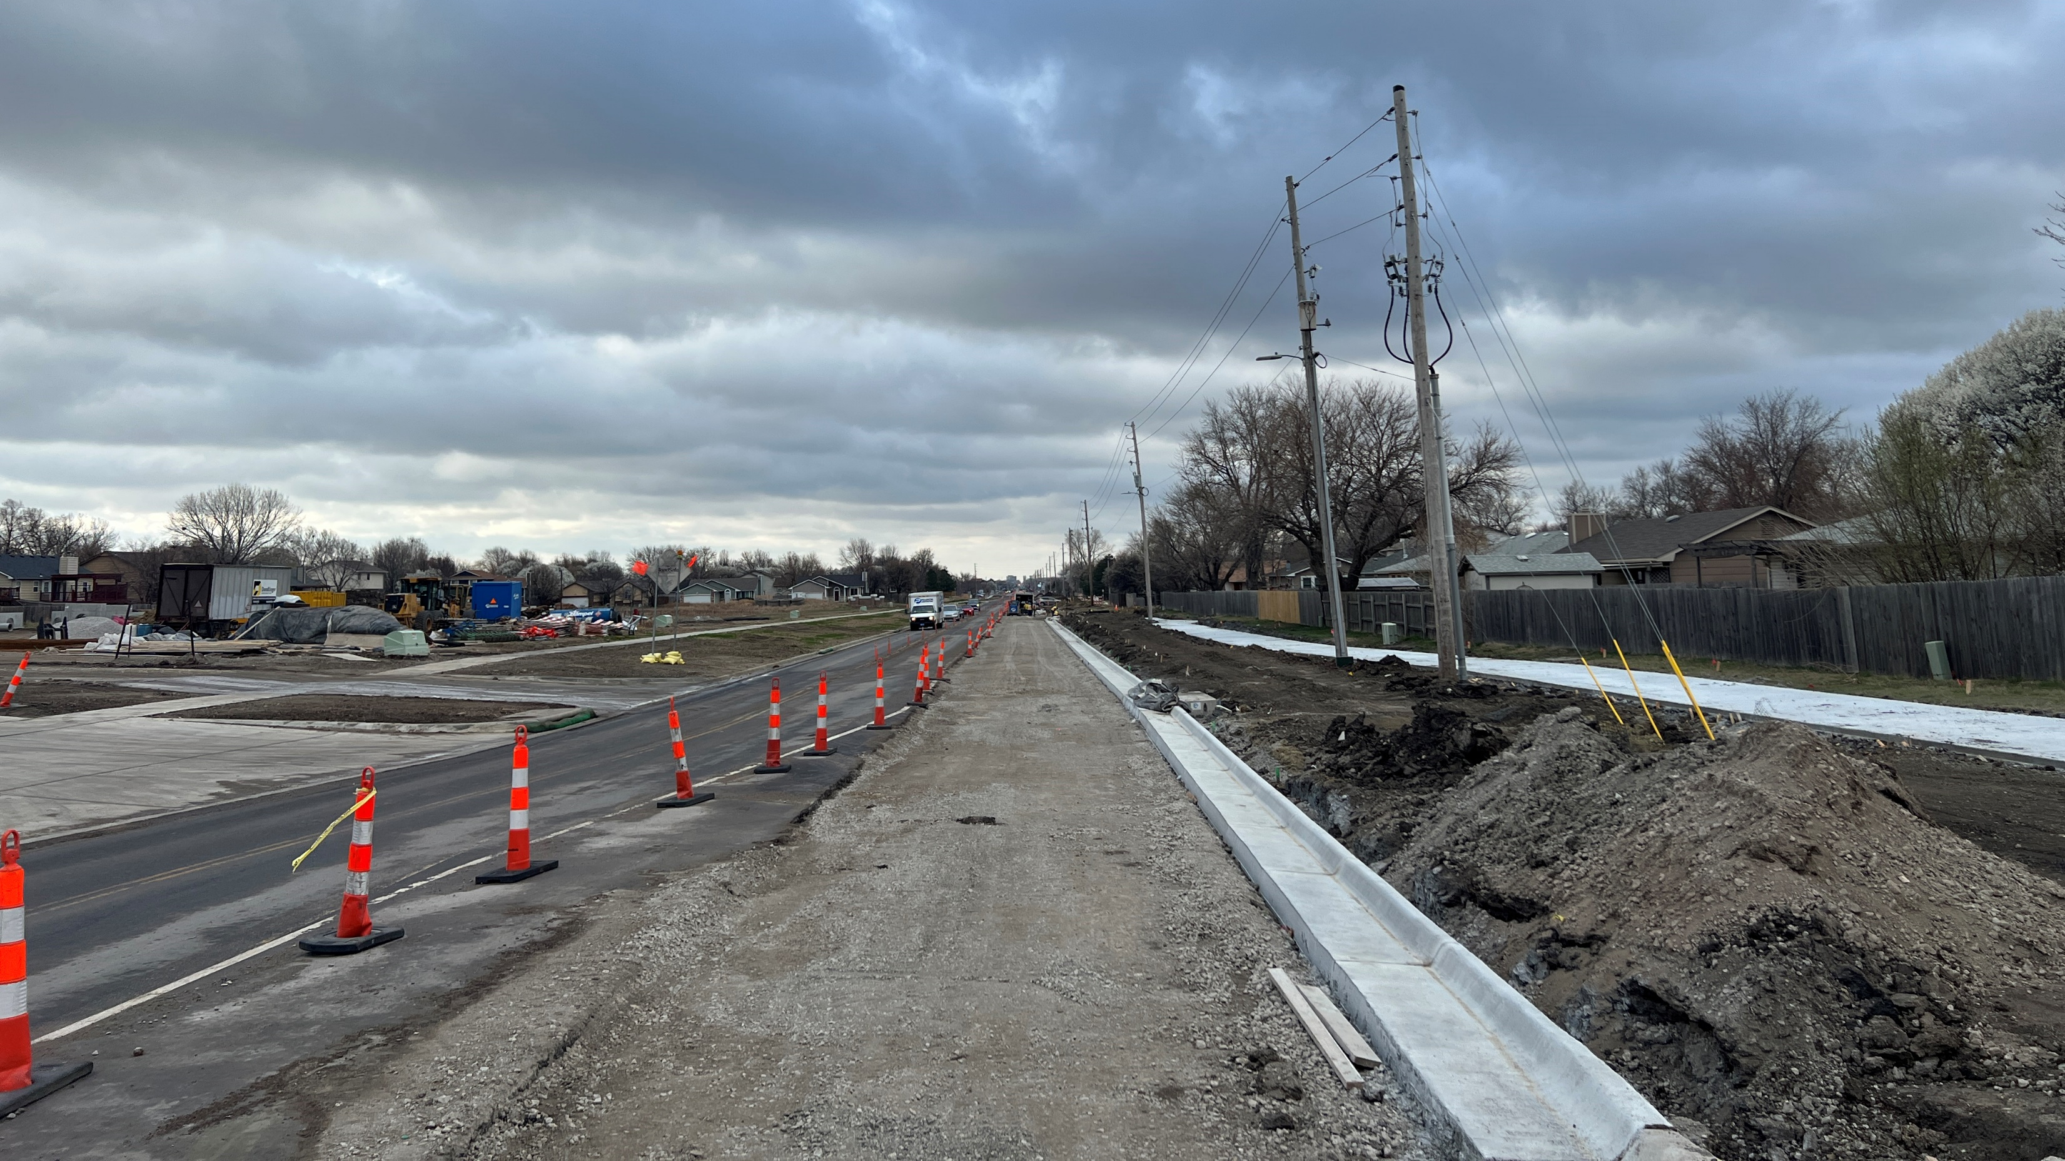
Current Activities

Slide 8
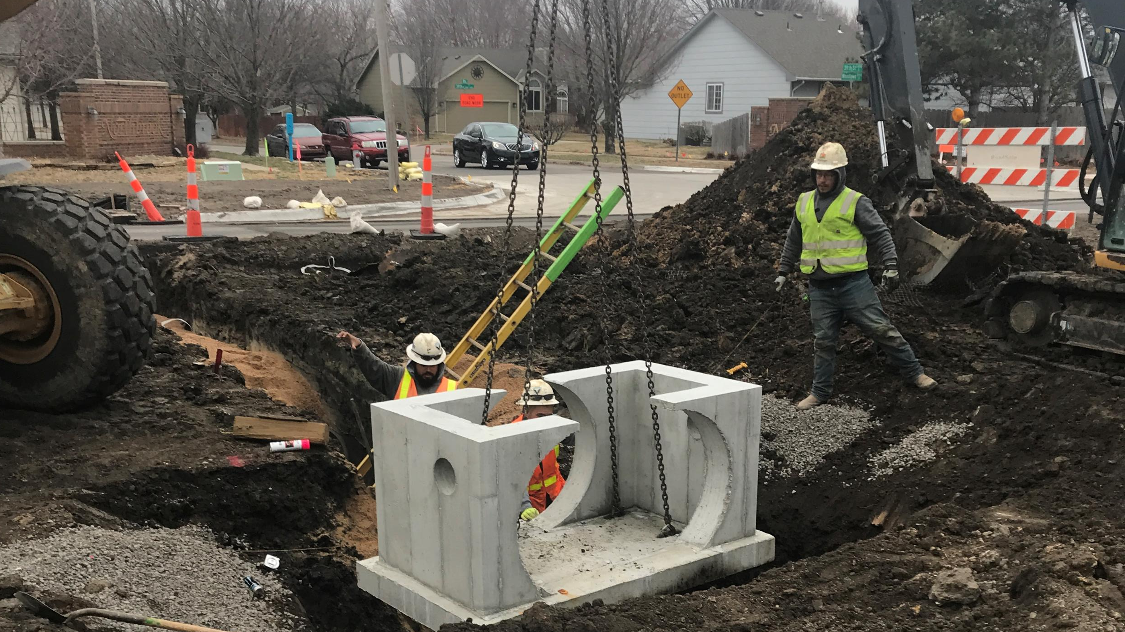
Current Activities

Slide 9
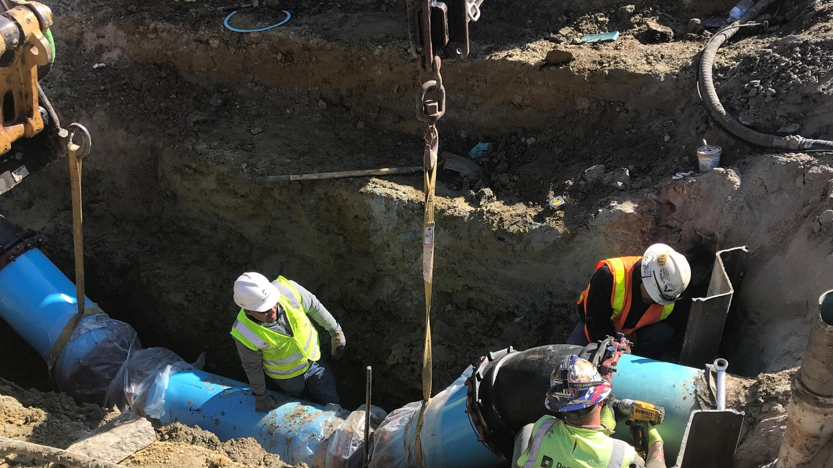
Current Activities

Slide 10
Project Phasing – Phase 2 (A-E)
  Construct East Portion of Woodlawn
2A
  Work on East Portion of Woodlawn
  Install Fire access road North of Quail Ridge
2B
  Continue East half of Woodlawn
2D
  North half of 45th
  NE corner of 45th intersection
2E
  West half of intersection at Woodlawn and 45th
  Complete utility and base paving operations within the right of way at the railroad intersection
³
  Utility work, grading, and paving operations along the west half of Woodlawn (Some of this work is happening now)
2C
  South half of 45th
  Work on SE corner of 45th intersection

Slide 11
Upcoming Activities
Asphalt paving operations expected to begin along the west half of Woodlawn within the next 2 to 3 weeks
Continue working on subgrade, base, and pavement at entrances to residential streets west of Woodlawn
Continue installation of storm sewer items south of the railroad tracks
Additional Activities
Railroad right of way utility and pavement replacement work scheduled to begin in mid to late April and continue through July
Through traffic at the railroad will be shut down during this timeframe
There will be north and southbound traffic on Woodlawn from 37th to 39th St AND 45th St to the Vet Clinic

Slide 12
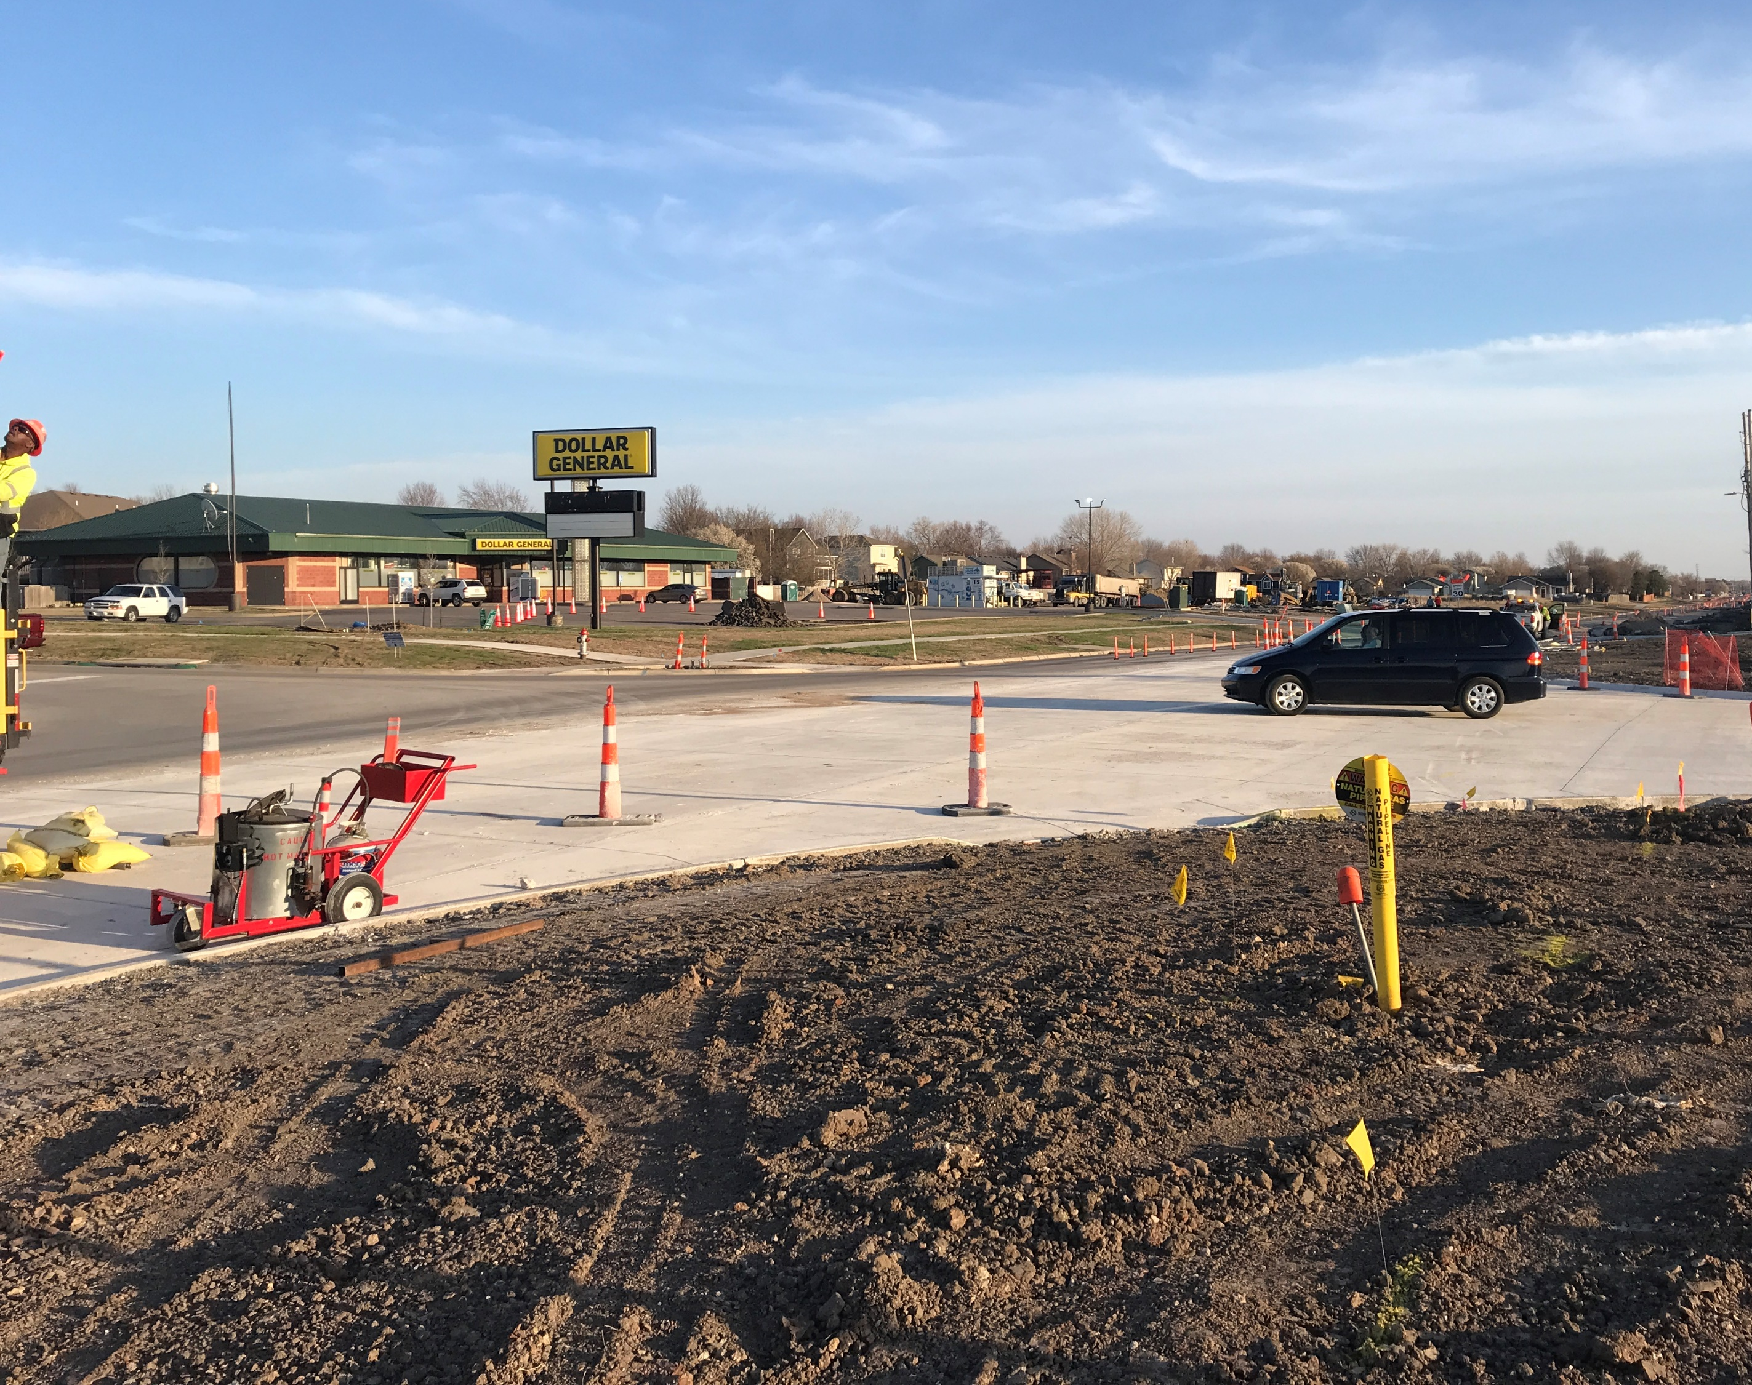
Traffic Flow

Slide 13
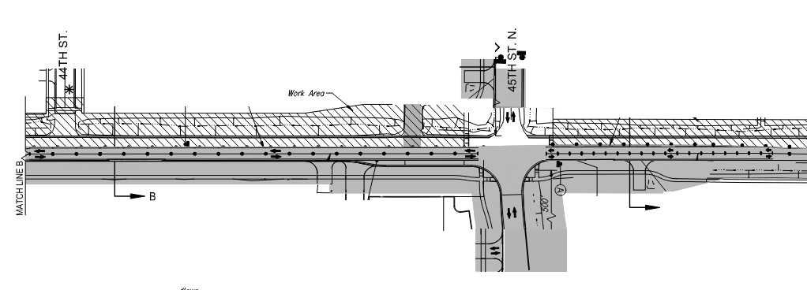
Traffic flow during railroad work area closure

Slide 14
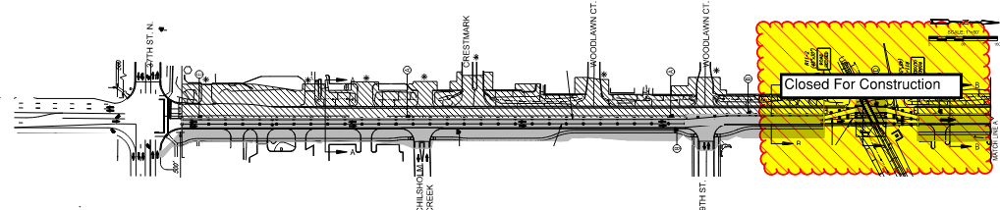
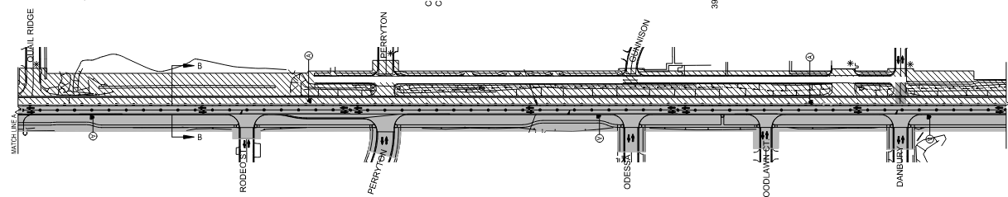
Traffic flow during railroad work area closure

Slide 15
Railroad Closure Details
Projected to begin this work in mid to late April and continue through the month of July
The traffic control will be very similar to the railroad closure that was done (by the railroad) a few weeks ago with the exception that 45th St. is now open in all directions
Crews will be installing sewer lines and manholes, a waterline, and rebuilding the pavement in and around the railroad right of way
Access will be allowed to all businesses and residents during this road closure

Slide 16
Questions?

